Slide 1
Black-Litterman Model in Portfolio Optimization with ML methods
Rui Zong

Slide 2
Content
Chapter I: How to choose Assets
Chapter II: Sentiment Analysis
Chapter III: BL Model Implement + Risk Analysis
Chapter IV: Conclusions & Improvements

Slide 3
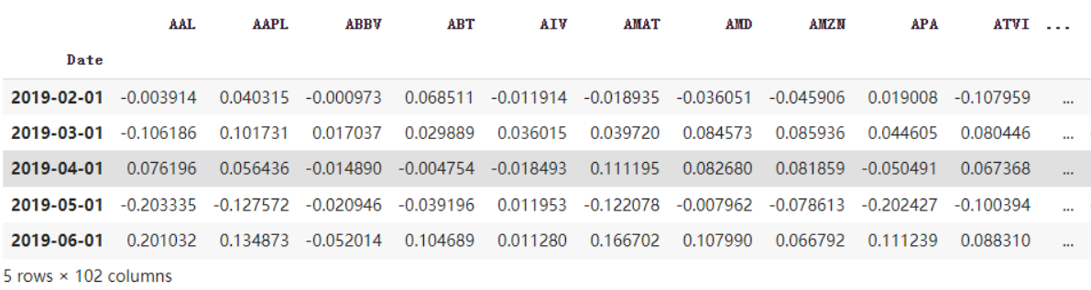
Data Collection
Time period: 2019-01 to 2022-09.
Monthly prices of 100 stocks in S&P500 from yahoo finance, including ‘AAPL’,’AMZN’,’GOOG’, etc.
Calculate monthly returns.
Monthly returns of SPY as the benchmark.

Slide 4
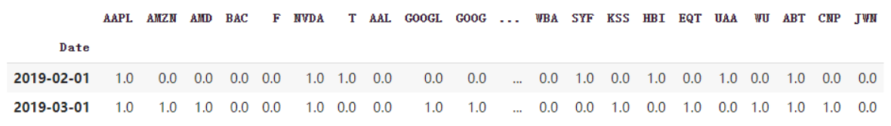
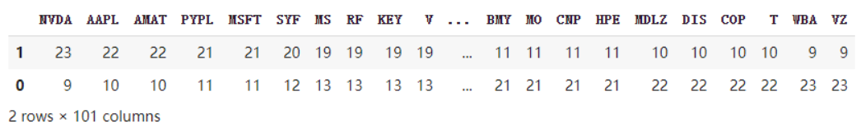
Asset Selection
Method 1:
Compare the returns of stocks with returns of SPY.
Label the return as 1 if it is larger than that of SPY otherwise label as 0.
Count the number of 1 for each stock and sort the stocks based on it.
Choose the top 20 stocks as output.

Slide 5
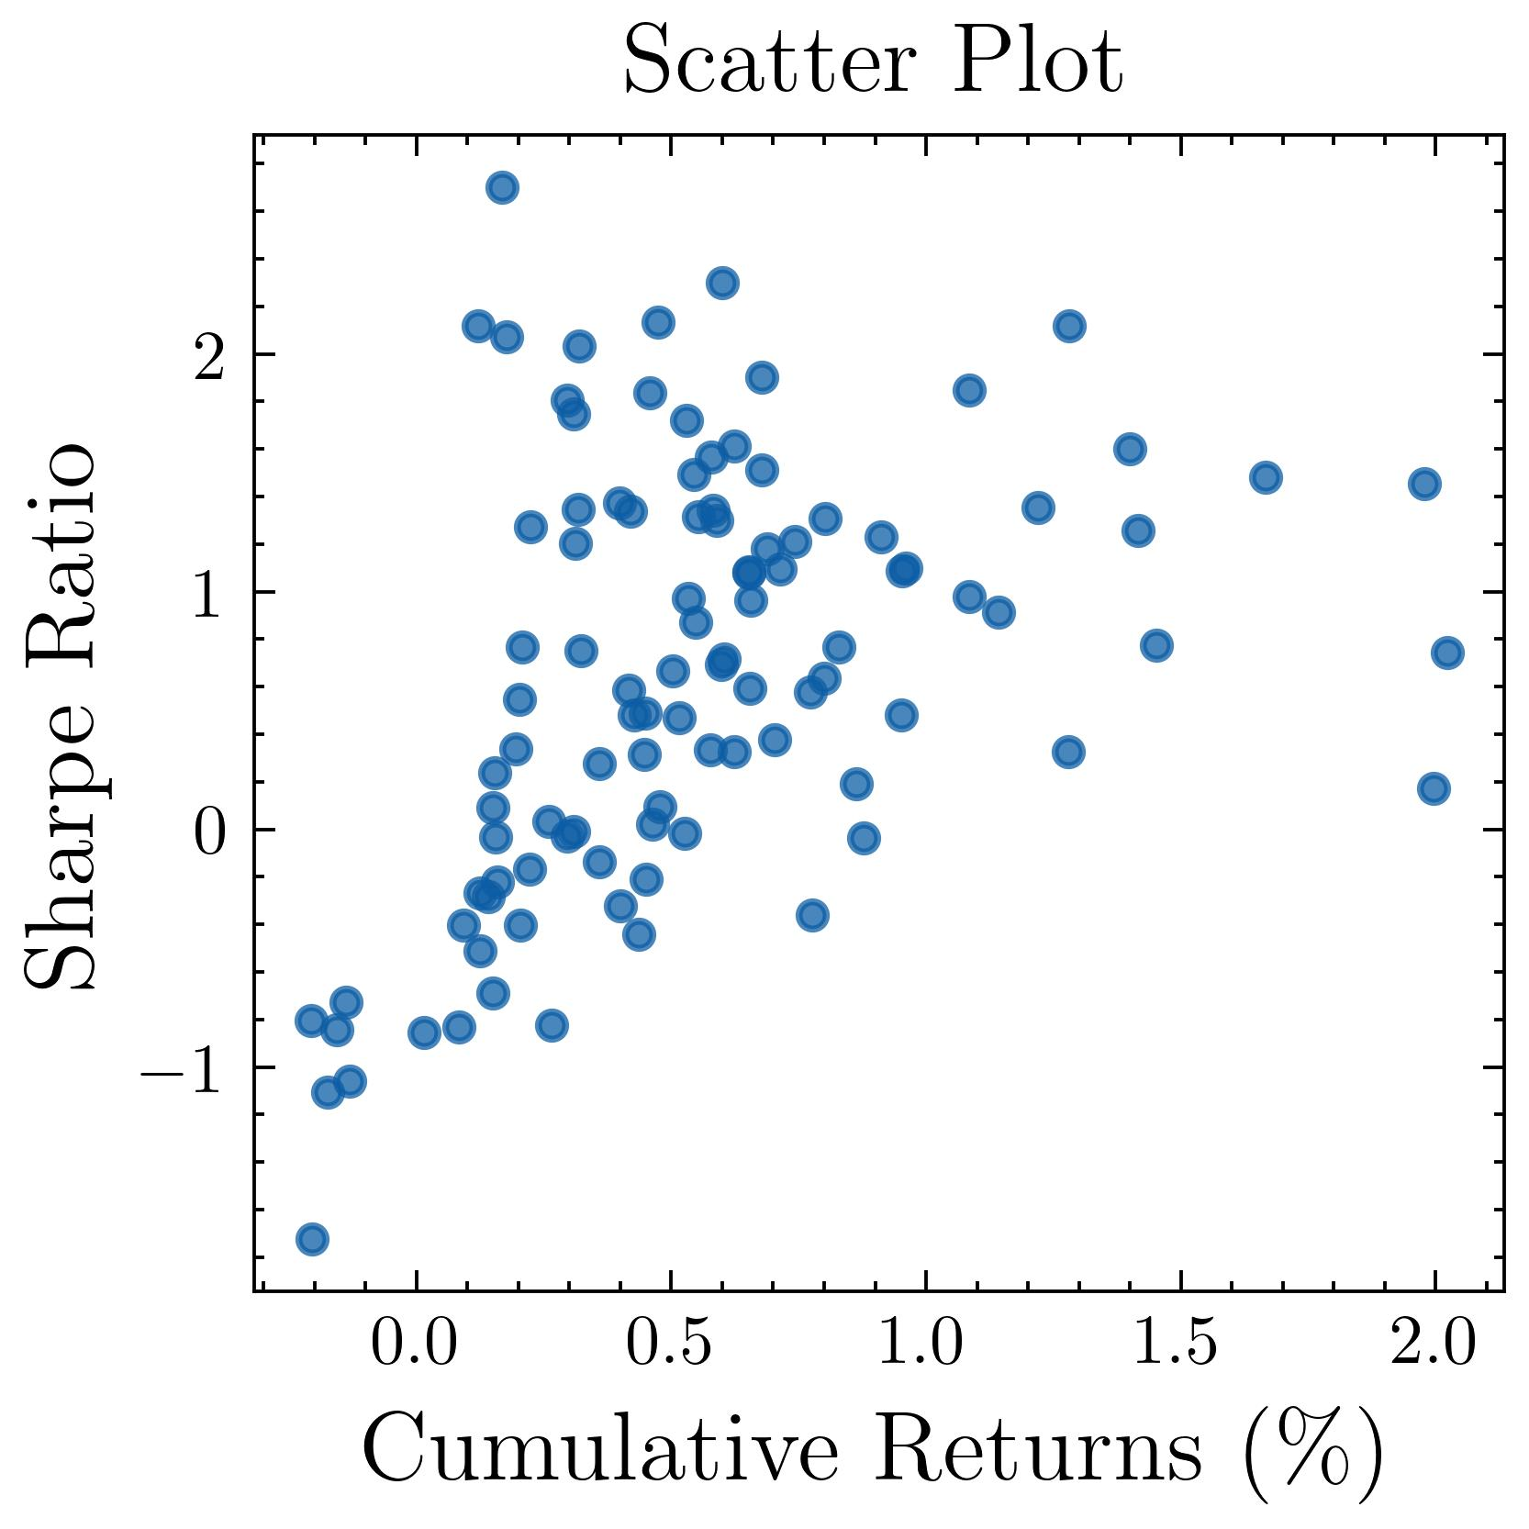
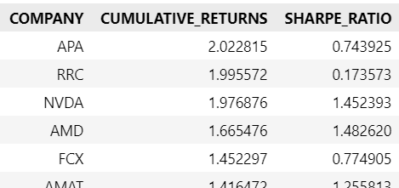
Asset Selection
Method 2:
Select companies with the largest returns
Most of these companies have Sharpe Ratio > 1
Every dot on the scatterplot shows the return, and
Sharpe Ratio for every company.

Slide 6
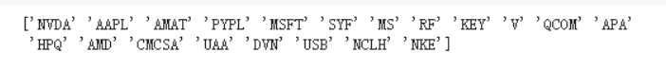
Asset Selection
Compare selection results from both methods and find intersection
Selection from method 1:
Selection from method 2:
Final asset selection:

Slide 7
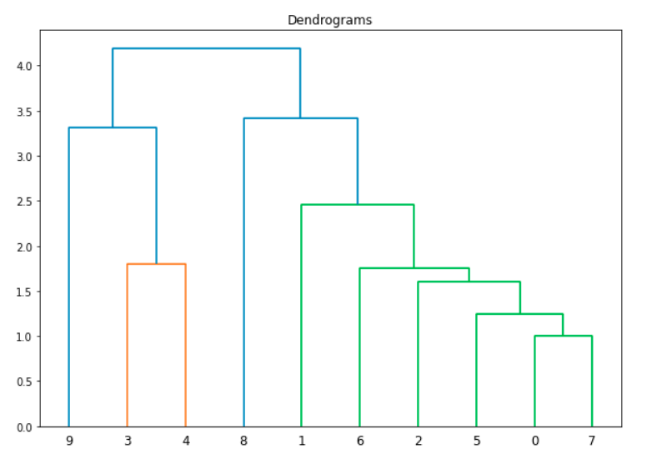
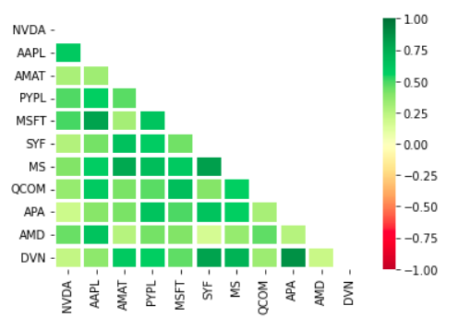
Assets Correlation & Clustering Test
All stocks are positively correlated.
No obvious clustering exists.

Slide 8
Chapter II: Sentiment Analysis
Idea:
We got the assets we want to research, so next step is doing sentiment analysis, then got the sentiment scores as our view to using in Black-Litterman for portfolio optimization.
Quickly review our assets
NVDA | AAPL | AMAT | PYPL | MSFT
1.9769 | 1.3991 | 1.4165 | 1.2200 | 1.0842
MS | QCOM | APA | AMD | DVN
1.0851 | 1.2800 | 2.0228 | 1.6655 | 1.2791

Slide 9
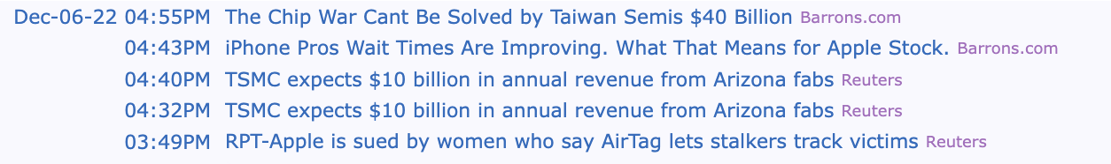
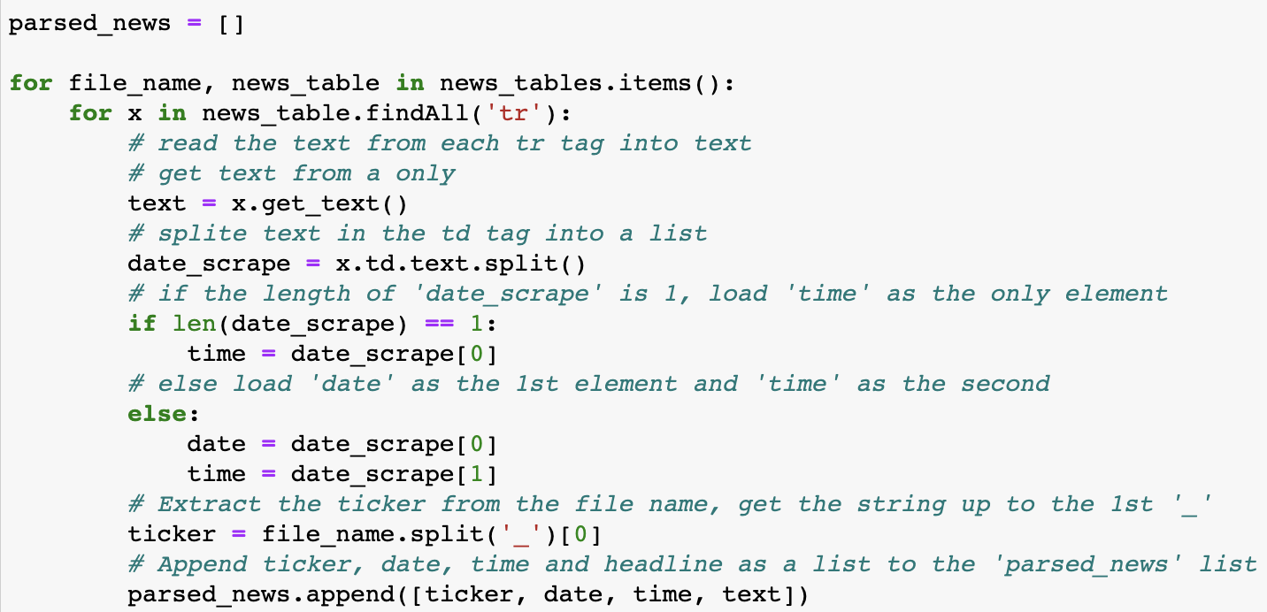
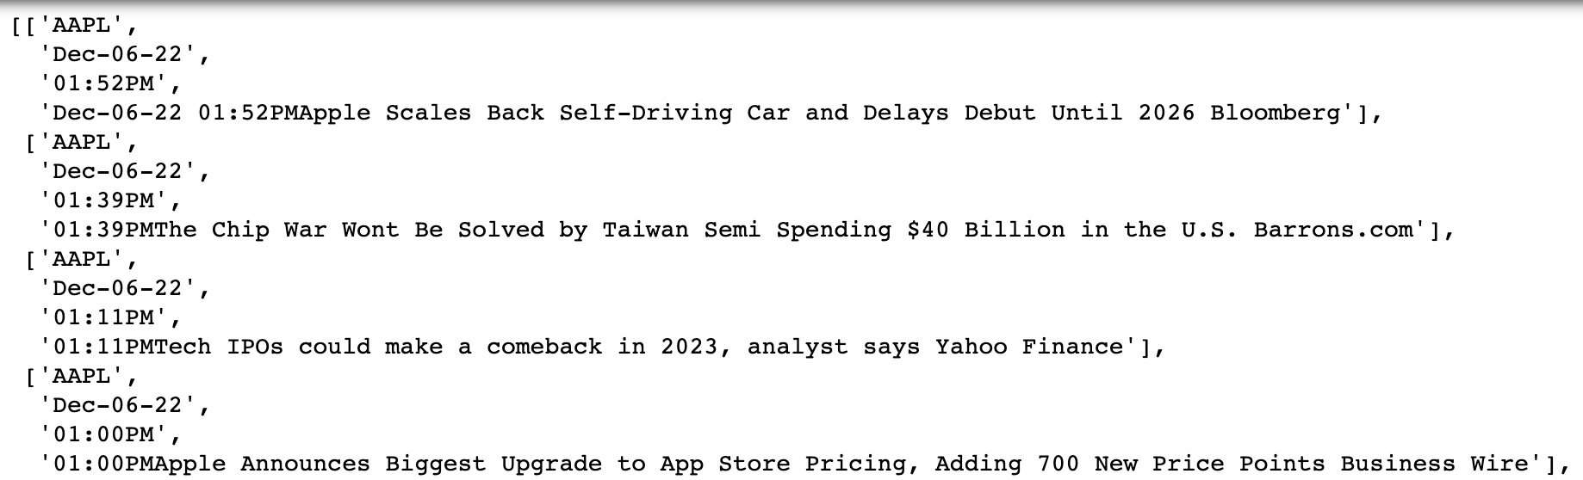
Chapter II: Sentiment Analysis
Sentiment analysis source
Website: https://finviz.com/

Slide 10
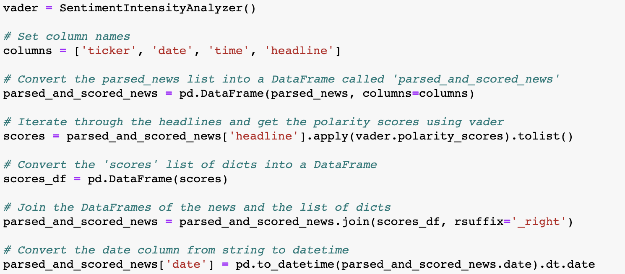
Chapter II: Sentiment Analysis
Vader Package
In Python, we use Vader package to do sentiment analysis.
Through code in left, we can get the sentiment scores (compound) for each asset.
Then, we use the mean of each news compounds as our sentiment scores.

Slide 11
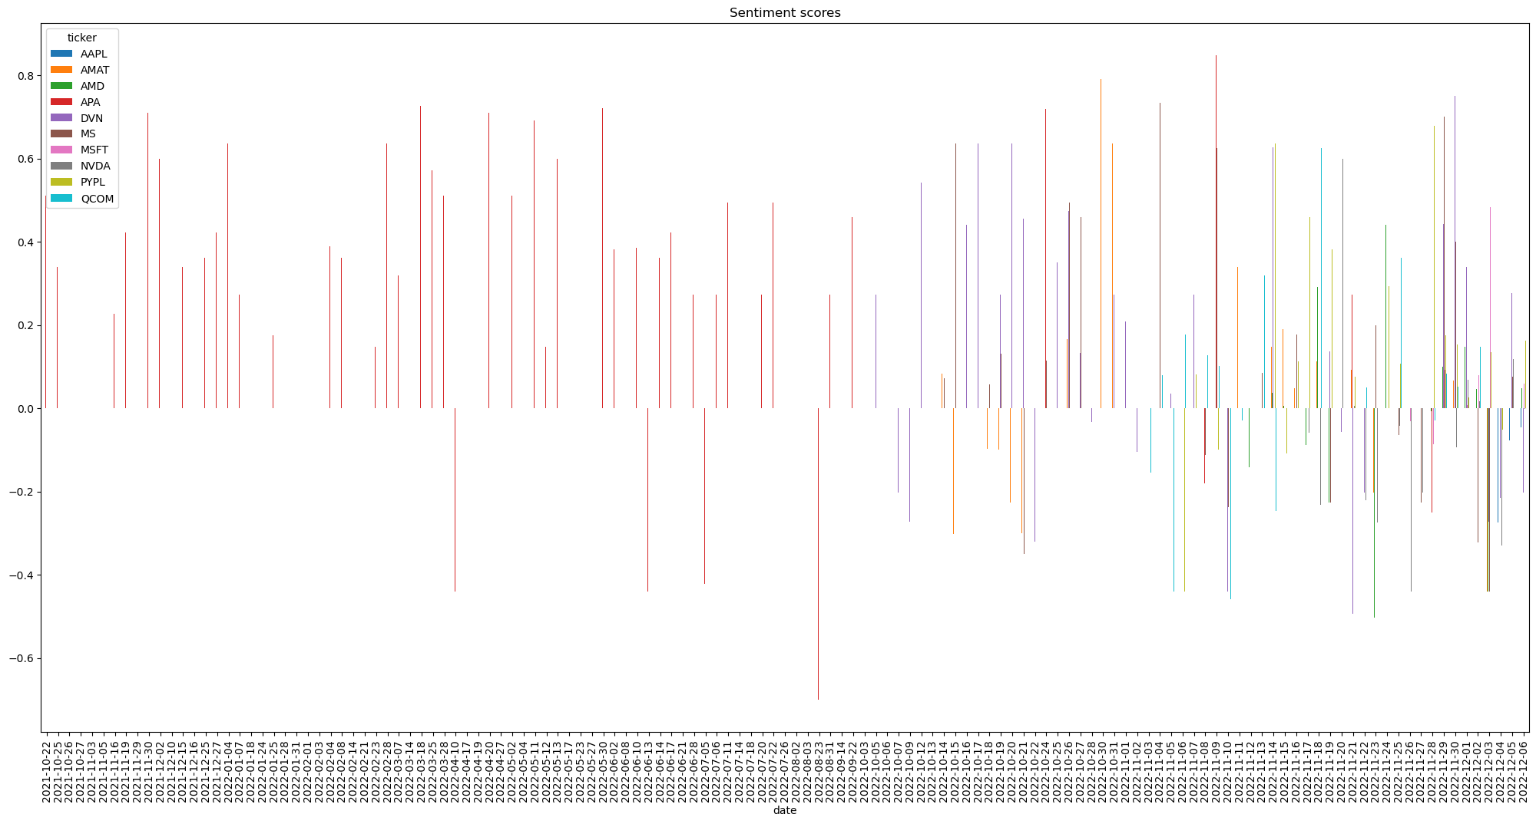
Chapter II: Sentiment Analysis

Slide 12
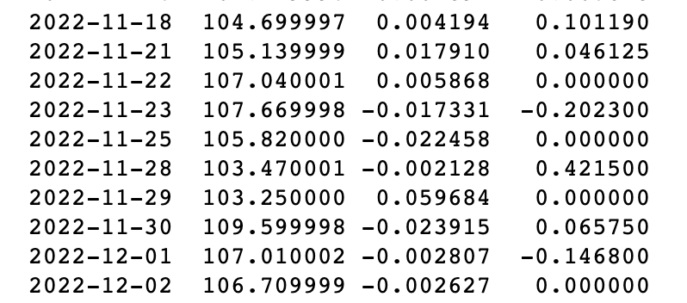
Chapter II: Sentiment Analysis
Correlations with returns and scores
Next, we combined the sentiment scores and the log-return to analysis the correlation between the scores we got from the analysis of the headline of news
the time we set is from 2022-11-01 to 2022-12-05
We download the prices of assets we used, and calculate the log-return, then combined with scores
Finally, we calculate the correlations which become the views in the Black-Litterman Model
Sample output

Slide 13
Chapter II: Sentiment Analysis
As we got the log-return and sentiment scores, we can calculate the correlation between them.
AAPL | NVDA | AMAT | DVN | APA
0.0112 | 0.3301 | -0.1490 | -0.2788 | 0.3047
MS | QCOM | MSFT | PYPL | AMD
0.5801 | -0.1076 | 0.2366 | -0.2367 | 0.0776

Slide 14
Chapter III: BL Model Implement + Risk Analysis

Slide 15
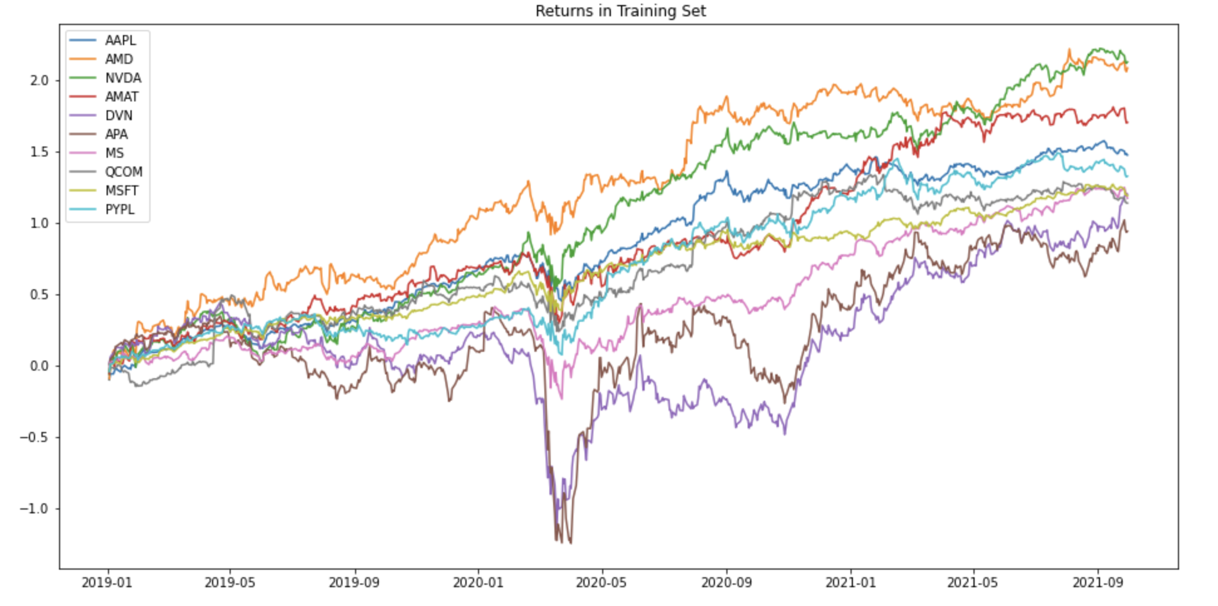
Chapter III : BL Model Implement
Returns in Training Set

Slide 16
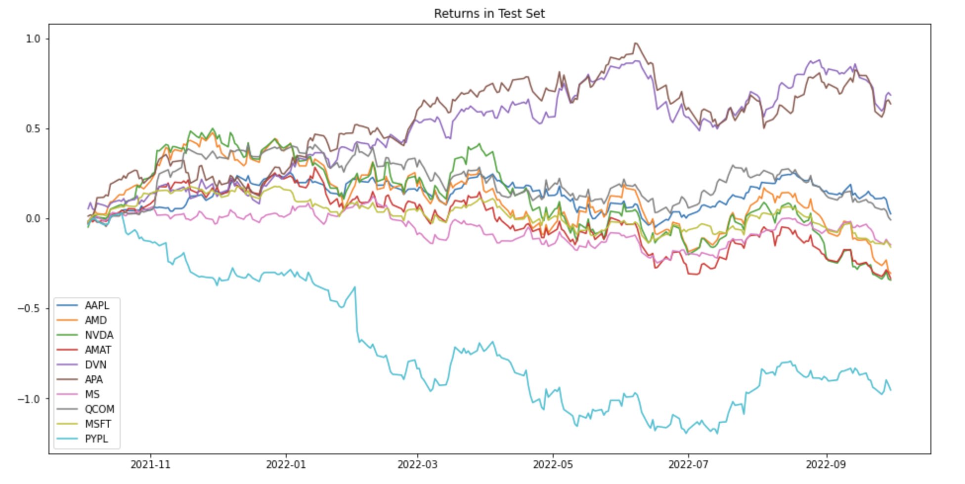
Chapter III : BL Model Implement
Returns in Testing Set

Slide 17
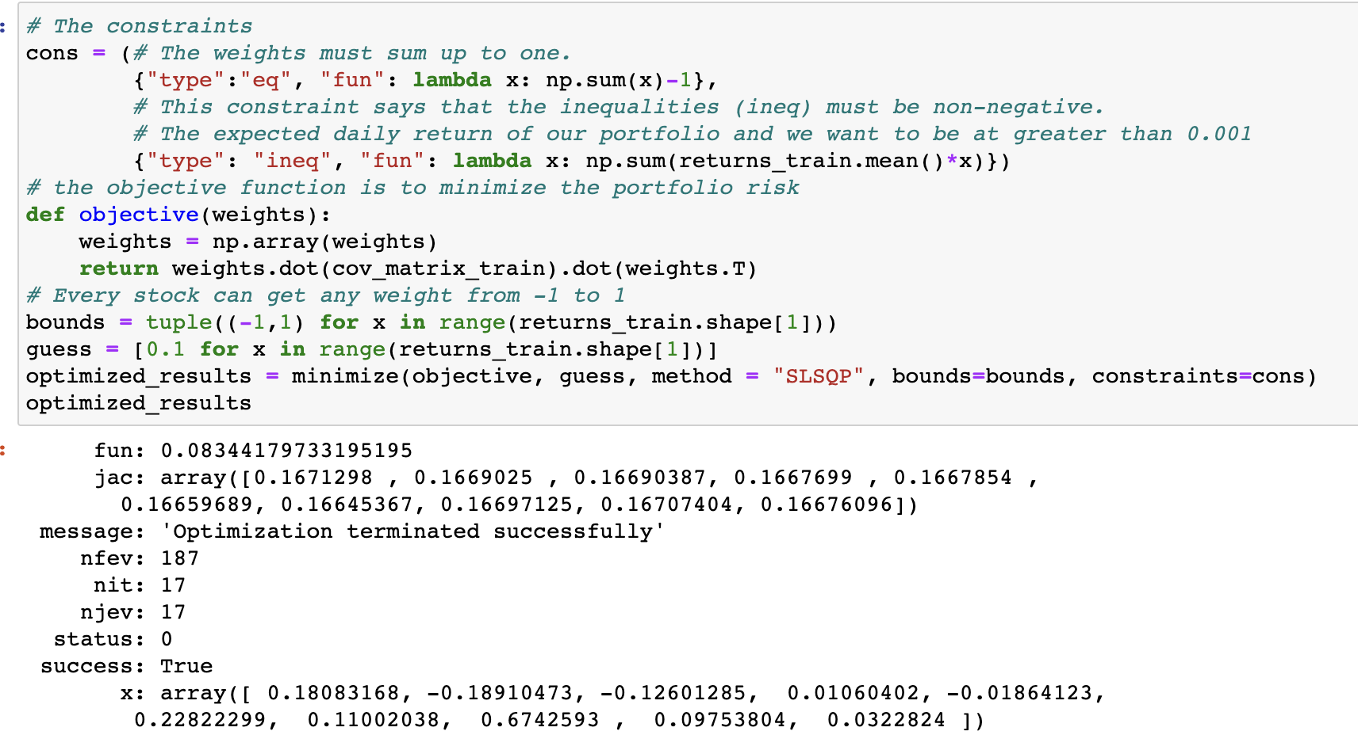
Chapter III : BL Model Implement
Original Mean-Variance Optimization

Slide 18
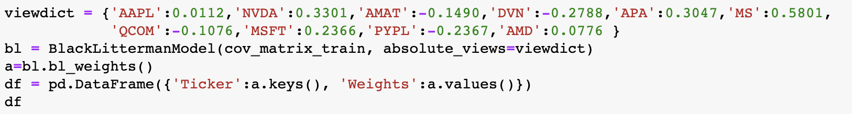
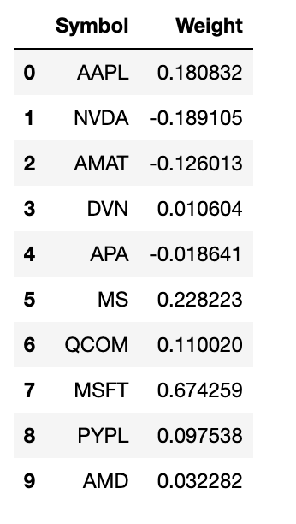
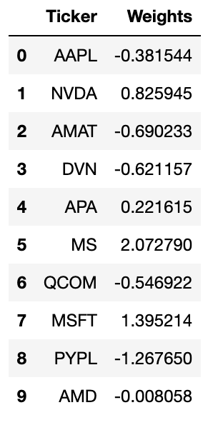
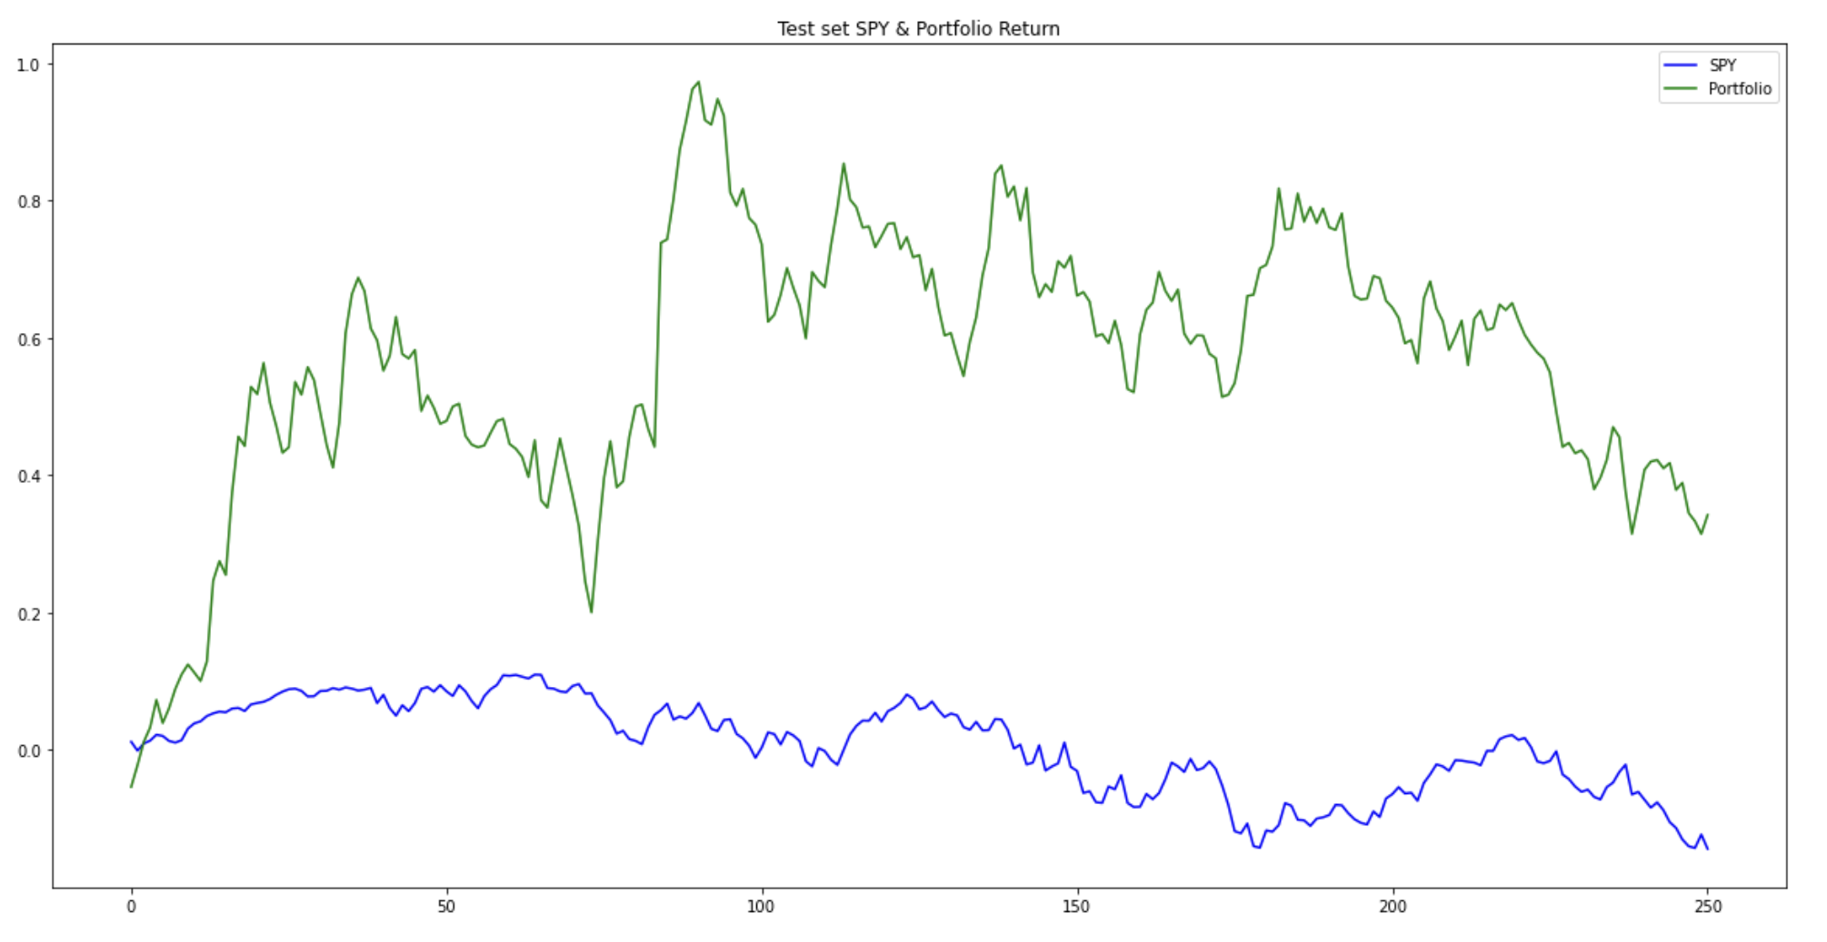
Chapter III : BL Model Implement

Slide 19
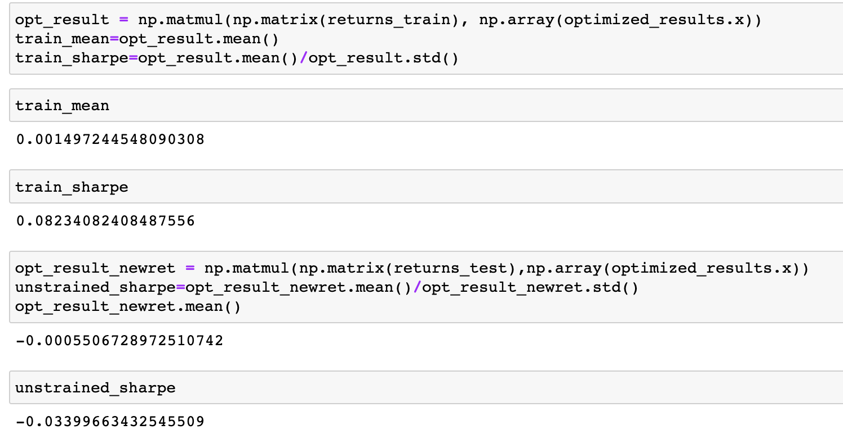
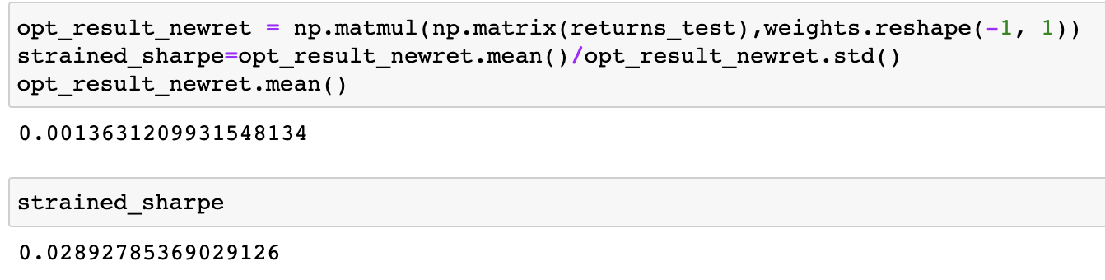
Chapter III : BL Model Implement
Original Portfolio
BL Model Returns

Slide 20
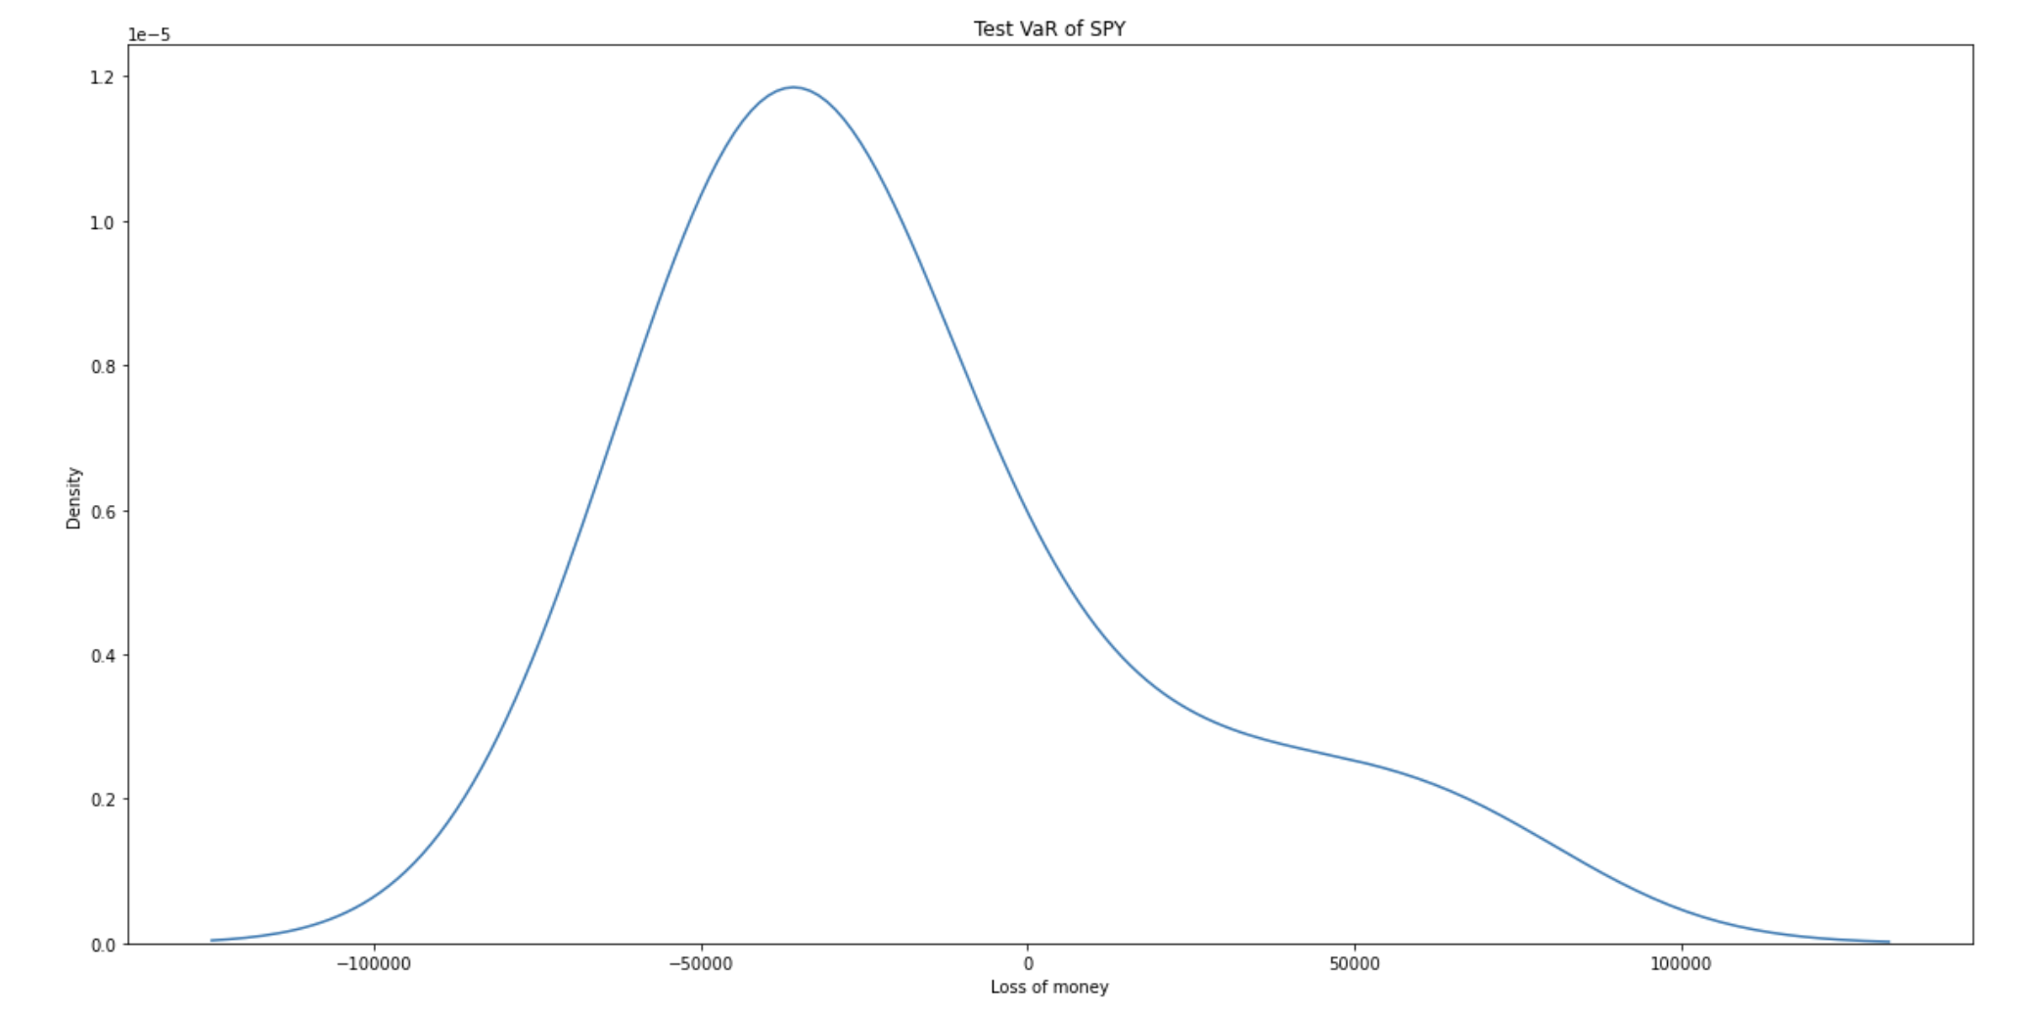
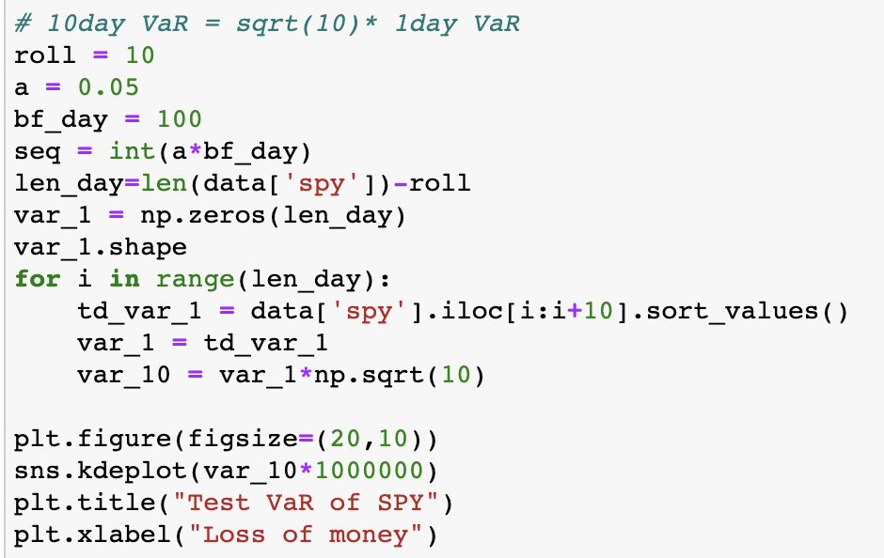
Chapter III : Risk Analysis 10-day VaR for SPY

Slide 21
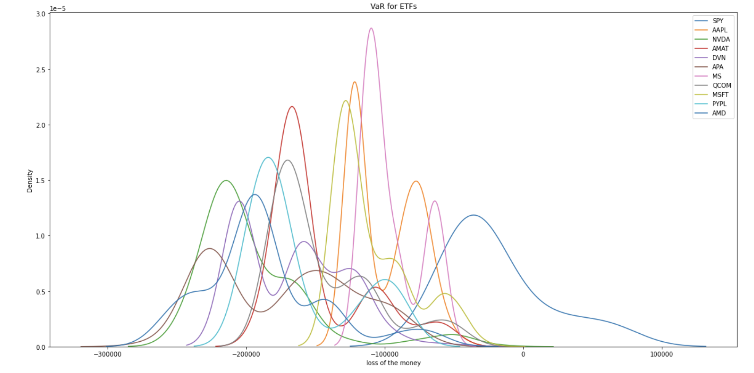
Chapter III : Risk Analysis 10-day VaR for Each Stock

Slide 22
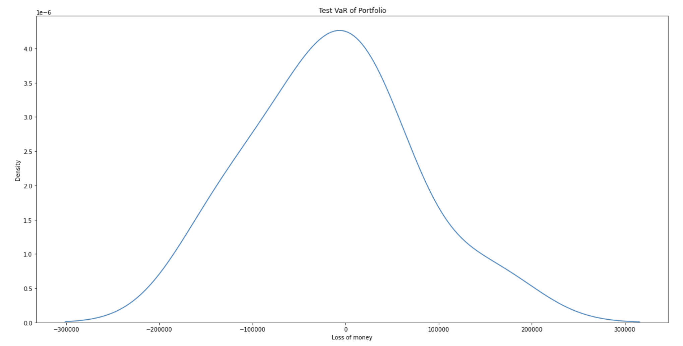
Chapter III : Risk Analysis 10-day VaR for Portfolio

Slide 23
Chapter IV : Conclusions & Improvement

Slide 24
Chapter IV : Conclusions & Improvements
Conclusions:
We try sentiment correlation scores as investors’ views for each asset on the training set and testing set.
This proves sentiment analysis do have positive influences on portfolio optimization.
Improvements if we have more time:
1. Try to use GANs (Generative Adversarial Networks) to simulate new test data (similar distribution with previous training data) for VaR calculation.
2. Combine with more Financial website Information, such as announcements from the Federal Reserve or Twitter. Change this calculate method for investment scores.
3. Employ this strategy with different kind of asset, such as futures.

Slide 25
THANK YOU
Stevens Institute of Technology
1 Castle Point Terrace, Hoboken, NJ 07030

